Slide 1
Value framework for Ontario’s nonprofit sector
With 55,000 nonprofits and charities, fuelled by five million volunteers, every Ontarian is connected to the sector.
So, what’s our collective story and impact? What value does Ontario’s nonprofit sector bring to communities across the province?
What does Ontario’s nonprofit sector mean to the economy, to democracy, to government and public policy, and to communities and the people in them?
Who this is for: Staff, Boards of Directors and other volunteers, and supporters of Ontario’s nonprofit sector.
How to use it: Use the messaging to help tell your story and promote your work this election year. Political parties and candidates will be eager to hear effective solutions, great ideas for doing things differently, and success stories. Share the impact you’re having. Talk about the issues your nonprofit and community care about.
Make it your own: You don’t have to use the messaging word for word. Cut and paste and adapt it. Take what resonates with your organization and the people you work with. Add your local data and impact of your organization!
The key is to tell your story, and how collectively we are the sector that brings people and groups together to create thriving communities.

Slide 2
[Nonprofits and Ontarians]
Every Ontarian is connected to a nonprofit -
whether through the cultural festival on the weekend, the environmental program at a local park, the social housing services, the hockey league at the town arena, the child care program, or the community research on food security.

Slide 3
[Nonprofits and Ontario’s economy]
Ontario’s nonprofit sector is a huge economic force, creating $50 billion in economic impact and employing over one million people. Its 55,000+ organizations contribute more to the province’s GDP than the automotive and construction industries combined.
Nonprofits help drive the strength and stability of our communities.
Canada’s nonprofit sector is the second largest in the world.
Nonprofits generate their own revenue, earning almost 50% of their income independent of government funding and grants.
Notes:
Source: Government of Ontario, Open for Business, Business Sector Strategy: Not-for-Profit Sector, August 2012 http://theonn.ca/wp-content/uploads/2015/05/O4B_final_EN_sept13.pdThe Nonprofit & Voluntary Sector in Ontario- Regional
Highlights of the National Survey of NonProfit and Voluntary Organizations (2006) p. 16
http://www.imaginecanada.ca/sites/default/files/www/en/nsnvo/d_ontario_sector_report.pdf

Slide 4
[Nonprofits and solution building]
We are the microphone and the monitor.
Nonprofits have an ear to the ground and are positioned to see firsthand when communities are struggling, and to mobilize people to create bold and lasting solutions.
Notes:
Listen to the Evidence: Identify issues, conduct research and recommend solutions.
We build healthy, thriving communities and celebrate their diversity and inclusivity.

Slide 5
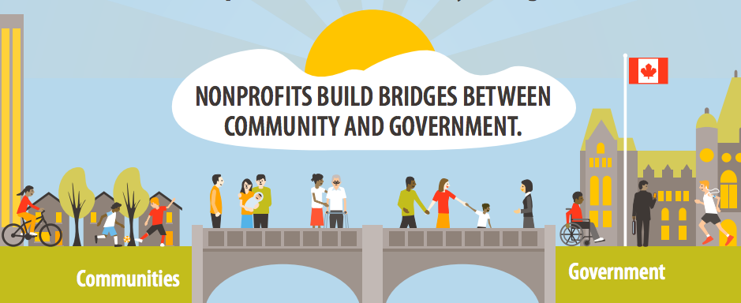
[Nonprofits, democracy and government]
Nonprofits make democracy stronger. They stand up for our right to education, shelter, food security, labour rights, a healthy environment, and more. They work to ensure everyone has a say in how public resources are used.
They play an active role in public policy, building bridges between community and governments. They help people navigate complex systems and provide effective solutions to challenges. Nonprofits amplify our diverse voices to hold government accountable and reflect the real needs of people and places.
Notes:
A recent survey of Canadians found that 61% of people don’t think current politicians have the solutions to address challenges in communities (2017 Edelman Trust Barometer- Canadian results). So, who does? Community!

Slide 6
[Nonprofits and volunteerism]
Not found in any other sector are
five million volunteers who are at the heart of Ontario nonprofits, donating 820 million hours to help organizations fulfill their missions- that’s the equivalent of 400,000 full-time jobs!
Notes:
Source: Government of Ontario, Open for Business, Business Sector Strategy: Not-for-Profit Sector, August 2012 http://theonn.ca/wp-content/uploads/2015/05/O4B_final_EN_sept13.pdf

Slide 7
[Nonprofits and inclusive economies]
The nonprofit business model leverages public investment, donations, social enterprise activities, and the passion of volunteers into community wealth that stays in community hands.
Nonprofits create and distribute value and wealth in more inclusive and environmentally sustainable ways through decent work, social enterprises, co-operatives, community land trusts, and more.
Notes:
Nonprofits build economic models that include everyone, through decent work, social enterprises, co-operatives,
community land trusts, and more. http://theonn.ca/postcards-collaborative-economy/

Slide 8
[Nonprofits and now]
Why does it matter now?
Complex challenges facing our world like climate change, racism, growing income inequality, and job automation make it all the more important for us to tell the story of the nonprofit sector and its role in meeting community needs led by community and values of care, craft and creativity.
Notes:
source: Care, craft and creativity
http://theonn.ca/postcards-collaborative-economy/

Slide 9
[Show your “Nonprofit Pride”]
Fast Facts
Add data, statistics, stories and more
What is the impact of your nonprofit or sector? How do you serve and support your community?
Notes:
Add your data on impact of your organization

Slide 10
[Nonprofits and communities]
Nonprofit organizations build healthy, thriving communities and celebrate their diversity and inclusivity.
They are the platforms that bring people and groups together to channel their energies and passion into creating opportunities and solutions that enrich their families, neighbours, and communities.

